Slide 1
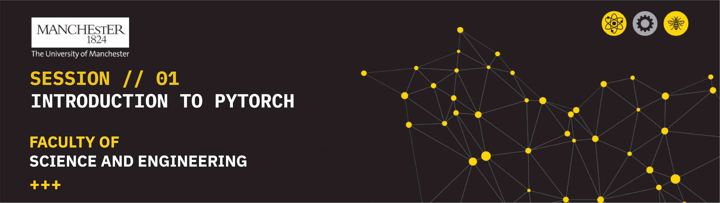
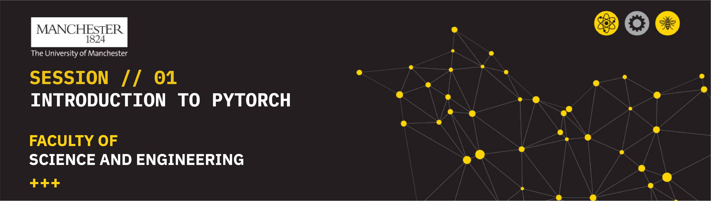
Session // 05 TRANSFER LEARNING FACULTY OF SCIENCE AND ENGINEERING +++
Diego Corona Lopez – AI Technical Specialist

Slide 2
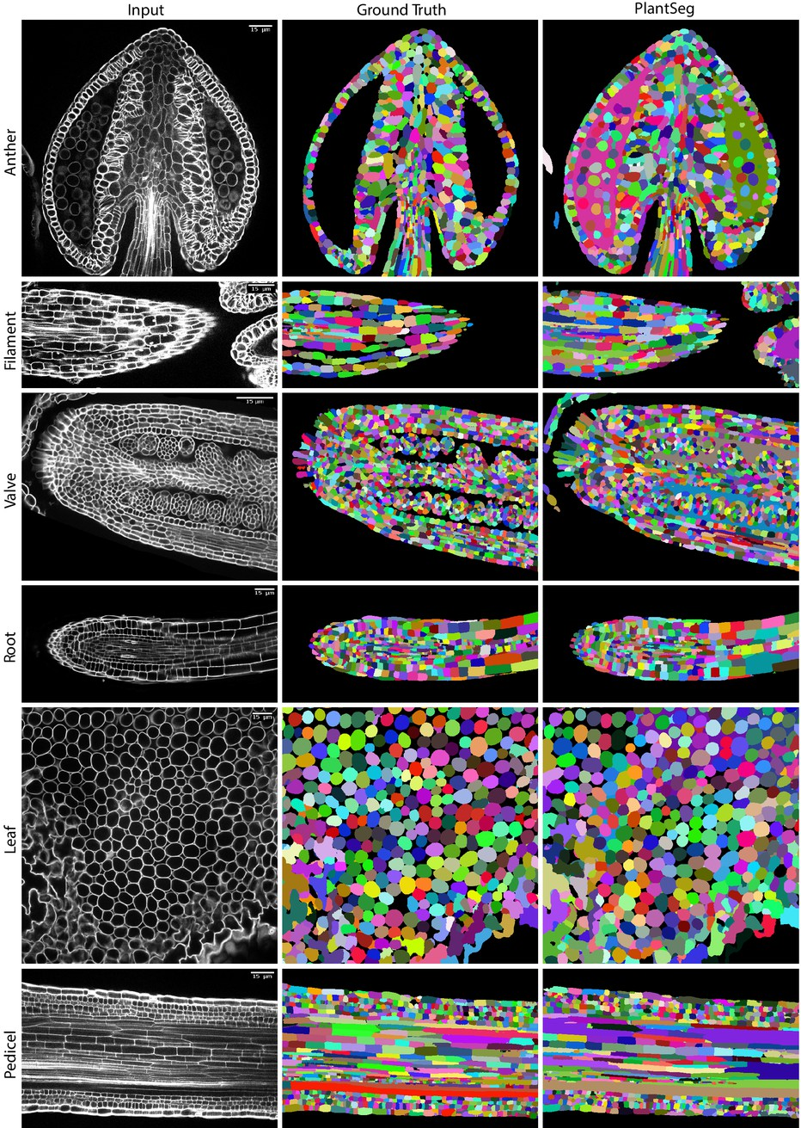
Agenda
Introduction to Transfer Learning
Definition and core concepts
Dataset Preparation
Creating PyTorch dataset classes
Computing dataset statistics
Data augmentation for medical images
Baseline Architecture
U-Net architecture overview
Implementation of encoder-decoder structure
Loss Functions for Segmentation
Dice Loss implementation
Transfer Learning with Pre-trained Models
Introducing EfficientNet architecture
Adapting pre-trained models for segmentation
Advantages of transfer learning approach

Slide 3
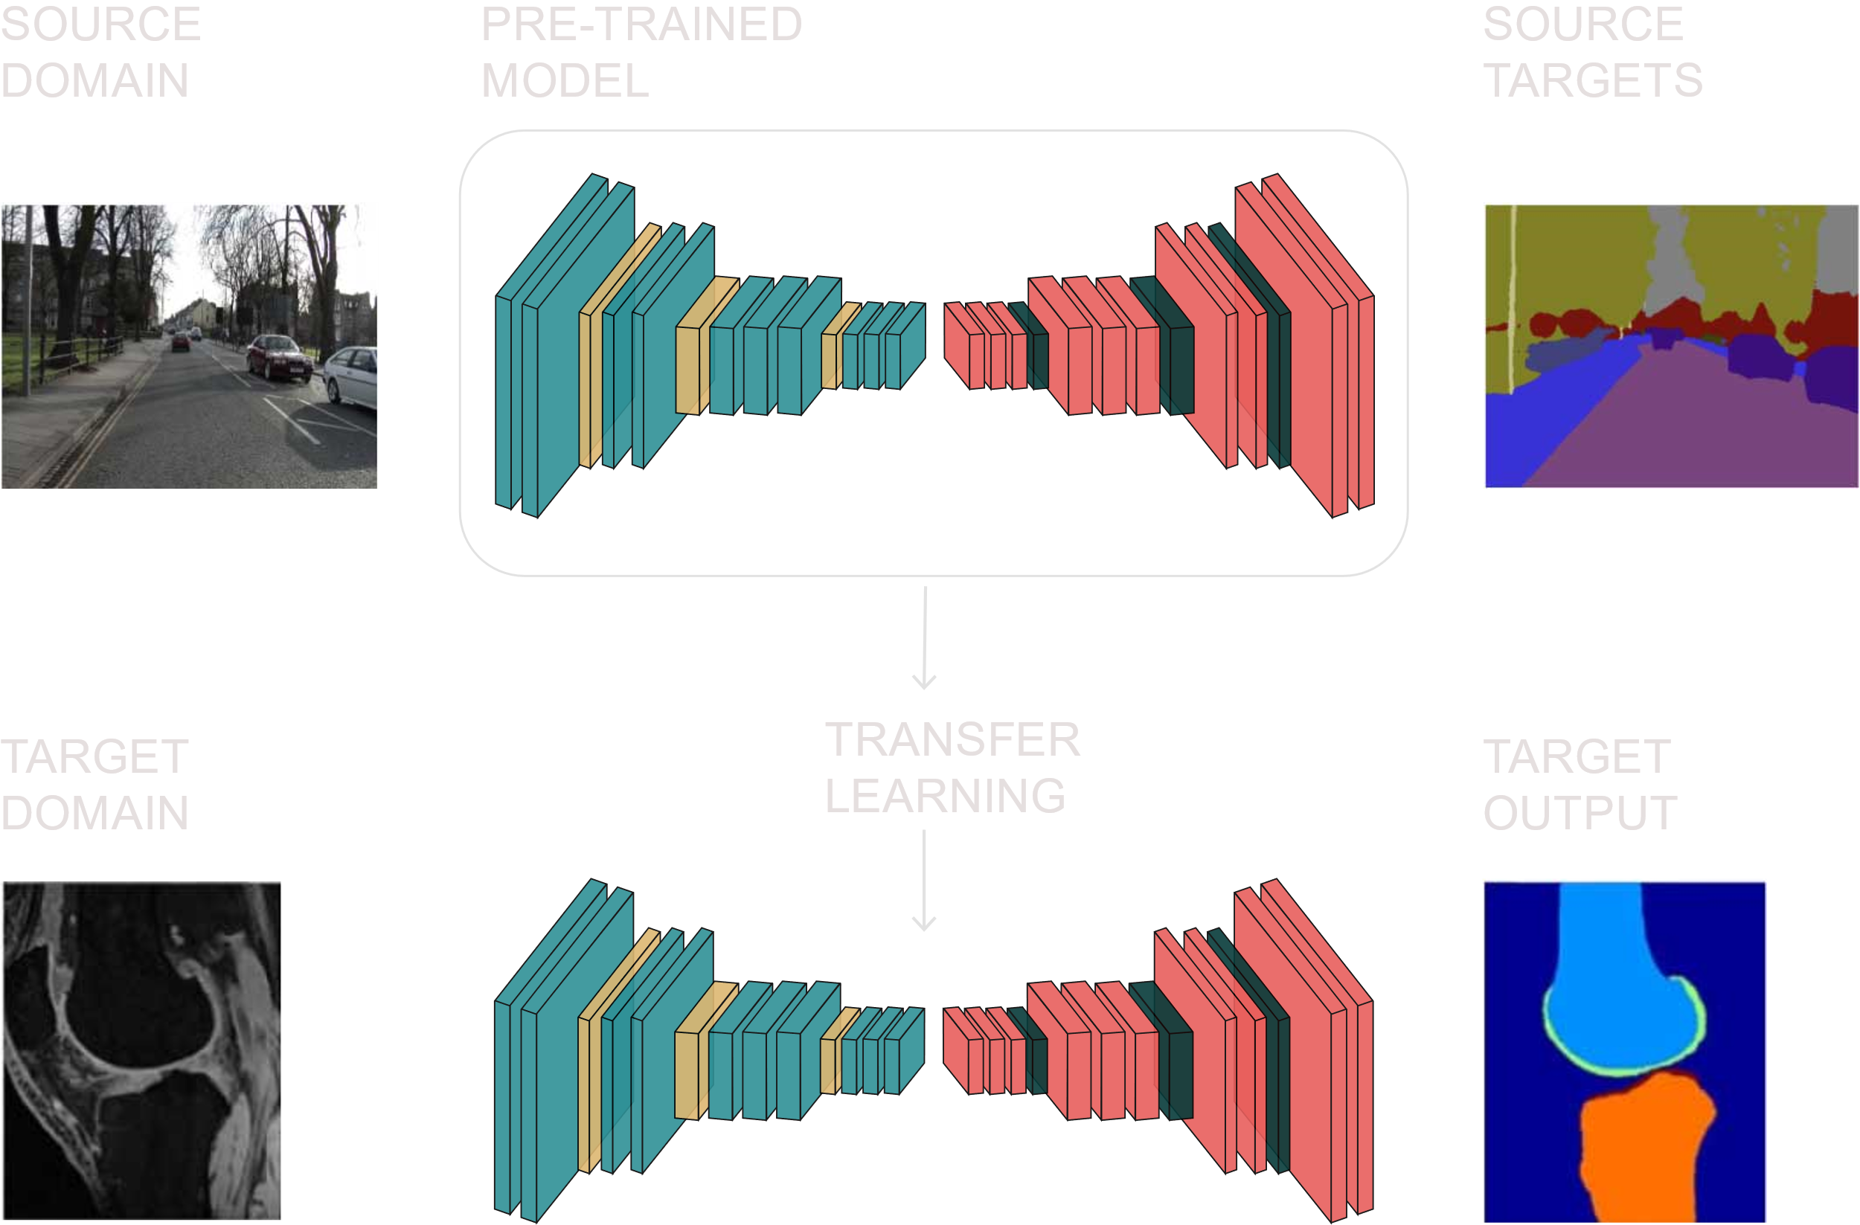
WHAT IS TRANSFER LEARNING?
A technique where a model developed for one task is reused as a starting point for a model on a second task. It leverages knowledge from pre-trained models instead of starting from scratch
It is particularly effective for deep learning models that require massive datasets and computational resources

Slide 4
When should YOU use transfer learning?
The effectiveness depends on similarity between source and target domains
SCENARIO | EXAMPLE | BENEFIT
Limited training data | Medical imaging with few samples | Pre-trained features compensate for data scarcity
Similar domains | From natural images to satellite imagery | Underlying features (edges, textures) transfer well
Time constraints | Rapid prototyping needs | Accelerates model development cycle
Hardware limitations | Training with limited GPU access | Reduces computational requirements
Preventing overfitting | Small dataset applications | Regularization effect from pre-trained weights
SE05
04

Slide 5
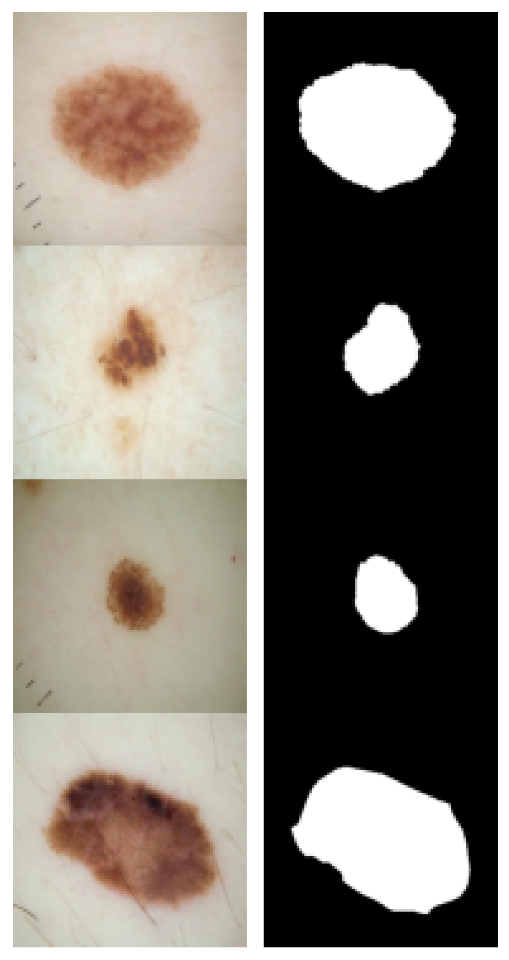
ISIC 2016 Skin Lesion Dataset
image
MASK
Medical datasets like ISIC are typically smaller than general computer vision datasets, making transfer learning particularly valuable
Contains dermoscopic images of skin lesions with expert-annotated segmentation masks
900 training images and 379 test images with corresponding binary masks
Critical for developing automated diagnostic tools for early melanoma detection
Challenging due to varying lesion sizes, shapes, colours, and skin types
SE05
05

Slide 6
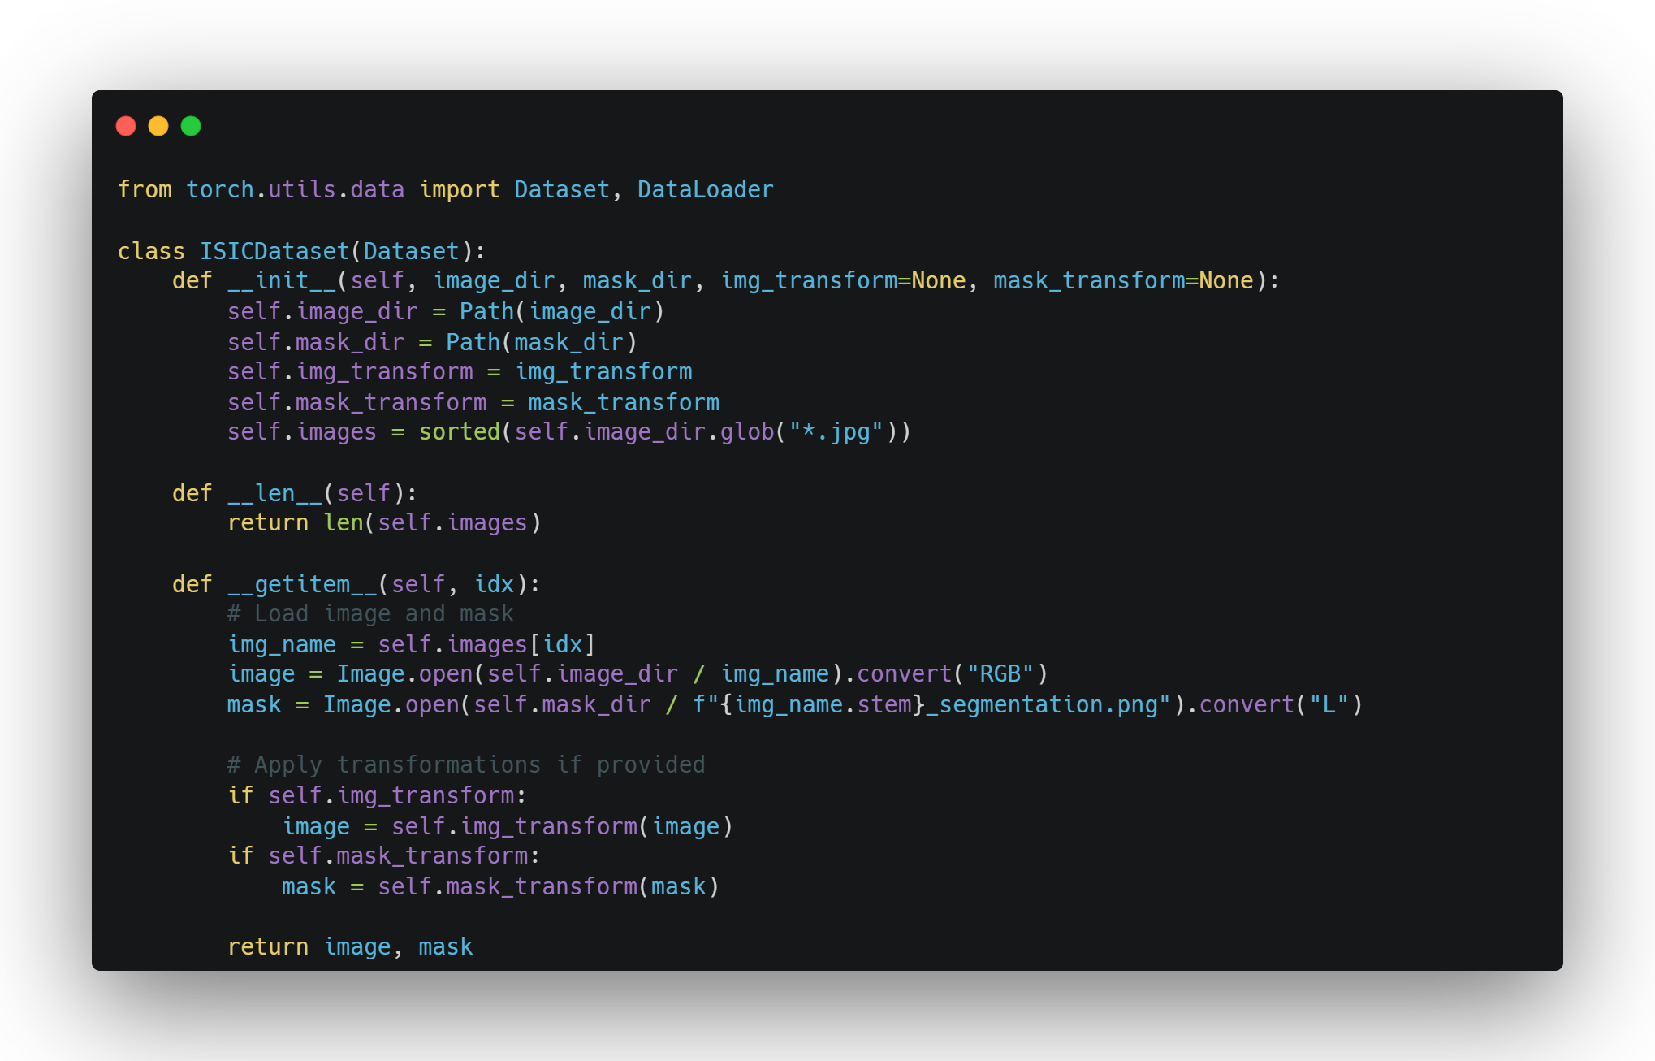
PYTORCH DATASET
PyTorch's Dataset class is the foundation for data loading
Three key methods:
__init__
__len__
__getitem__
Enables efficient data handling and batch processing

Slide 7
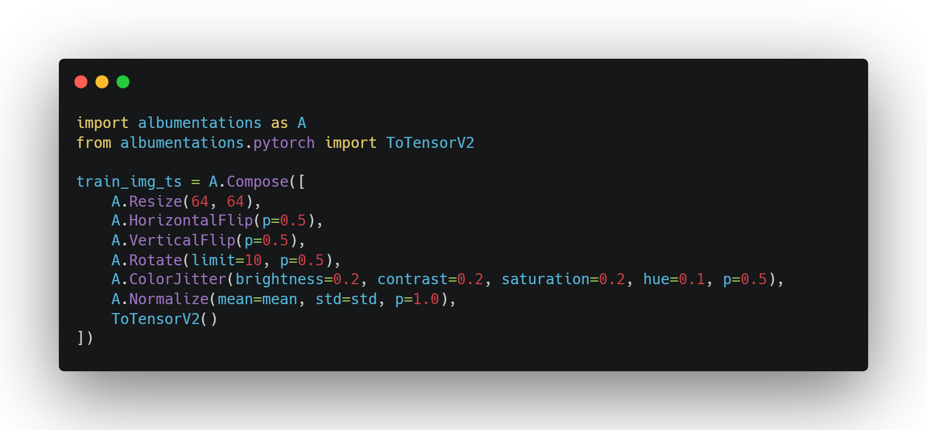
DATA AUGMENTATION FOR SEGMENTATION
Synchronized augmentation for images and masks
Careful selection of transformations to preserve diagnostic features
Geometric transforms: rotation, flipping, resizing
Color adjustments: brightness, contrast
SE05
07

Slide 8
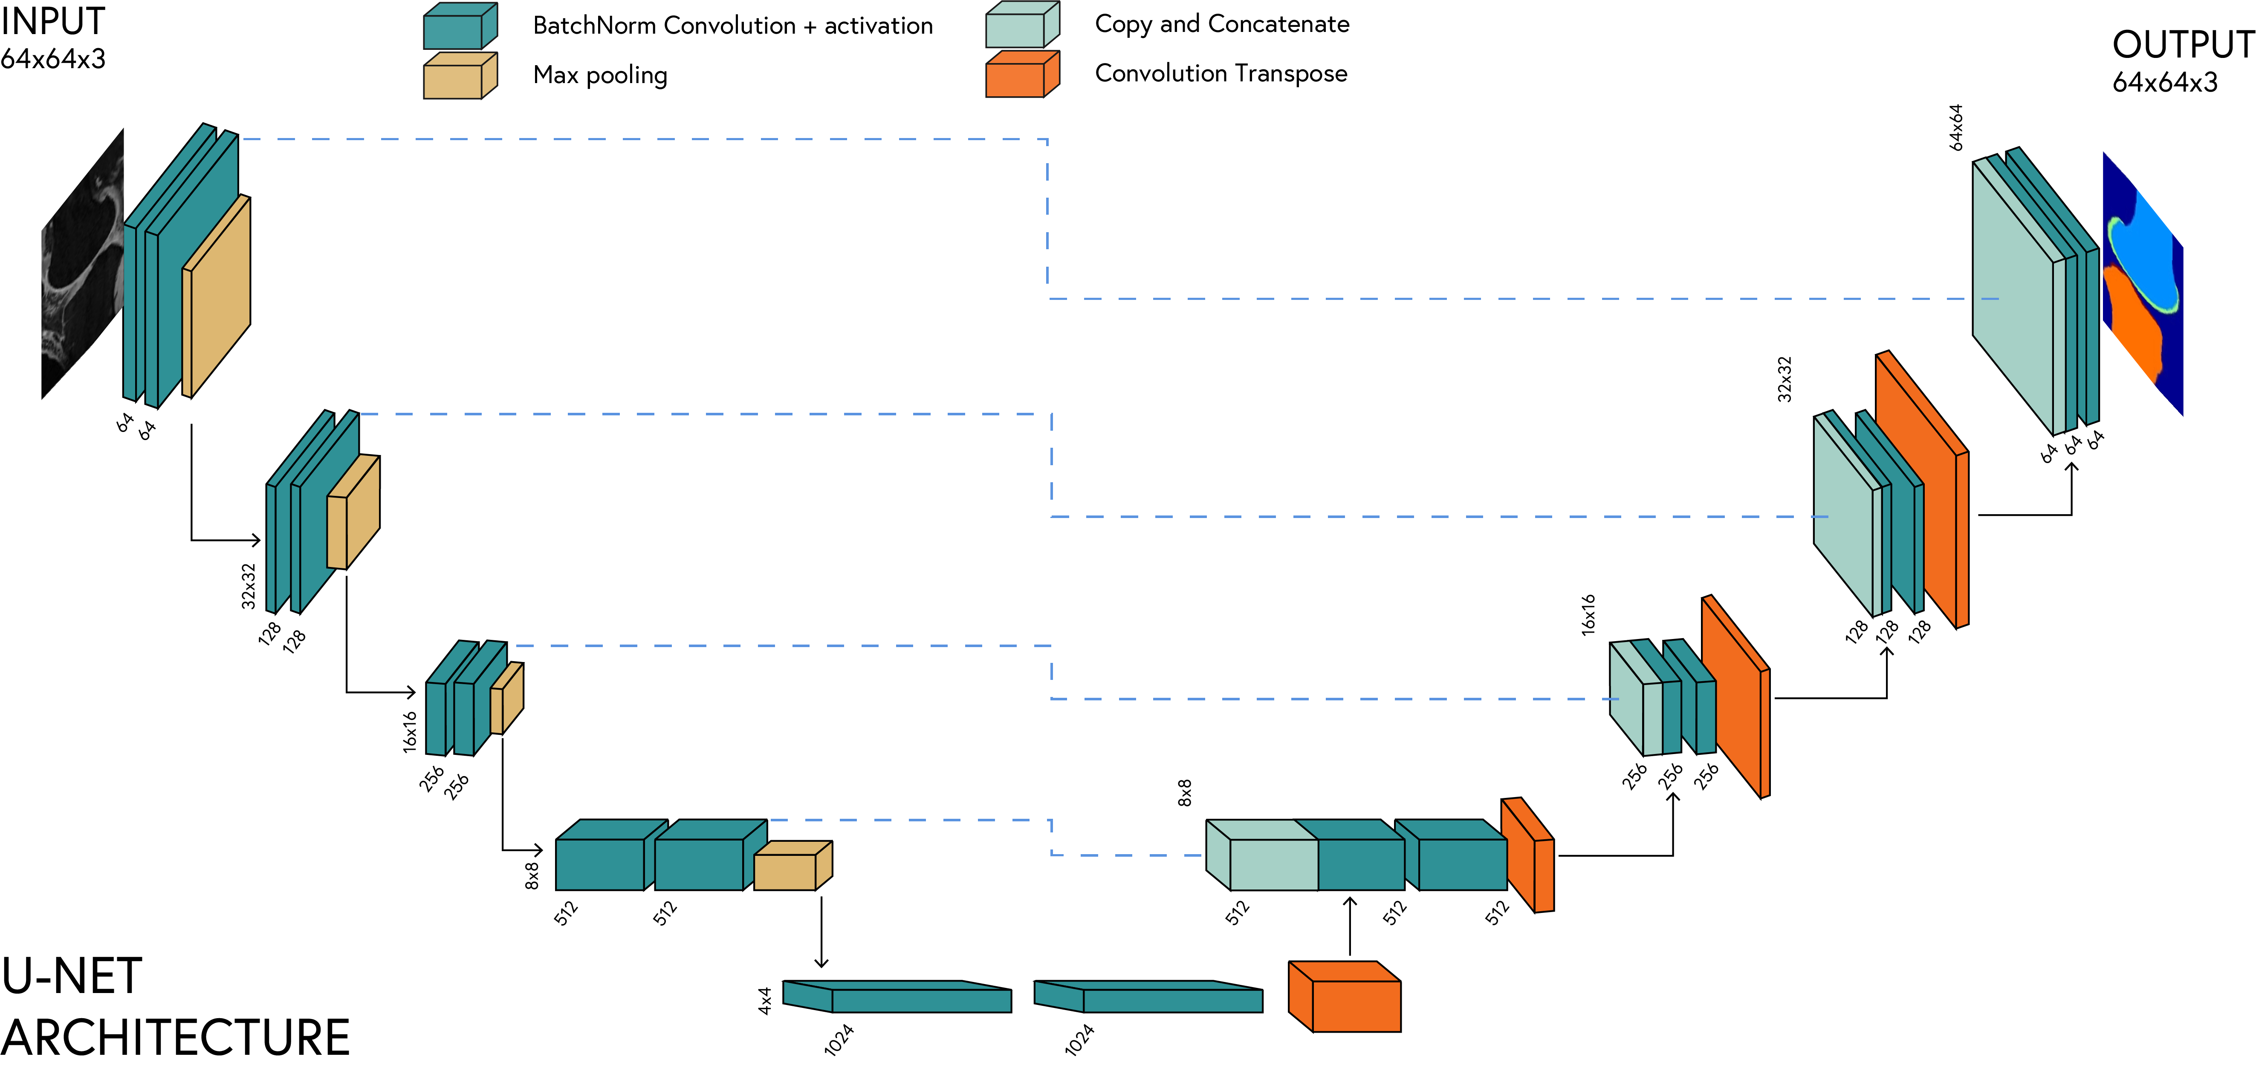
Encoder-decoder architecture with skip connections
Captures both context and localisation information
Widely used for biomedical image segmentation
U-NET
SE05
08

Slide 9
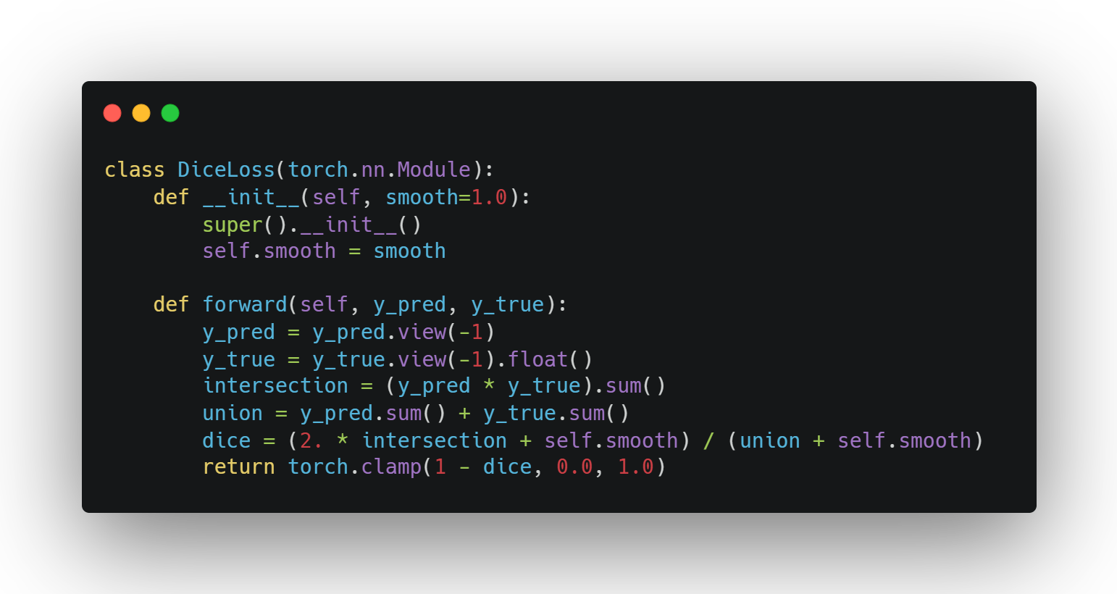
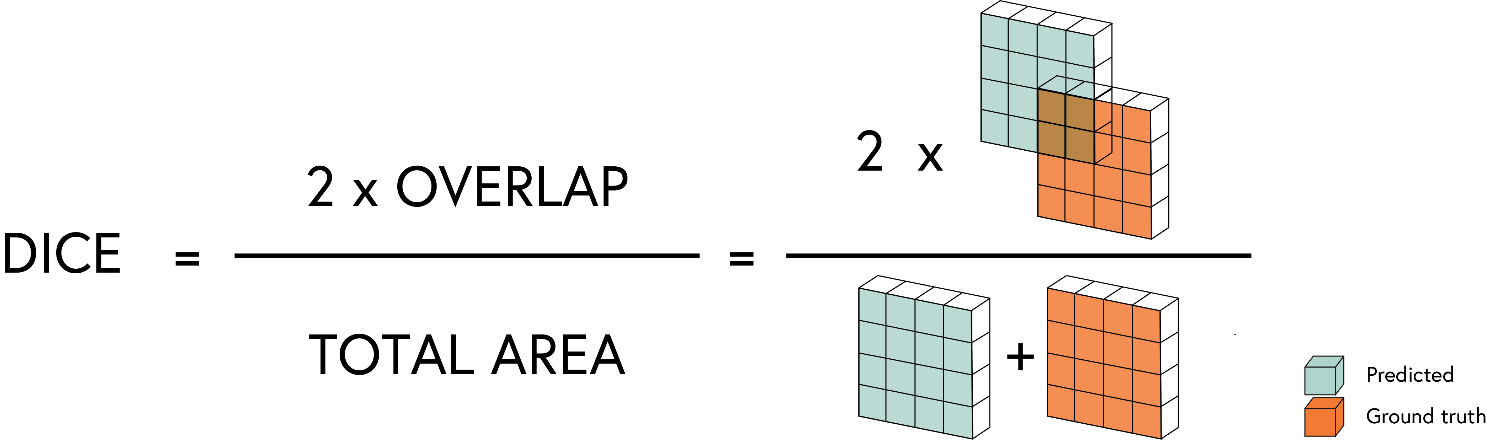

DICE LOSS
Measures overlap between predicted and ground truth masks
Handles class imbalance better than binary cross-entropy
$$\text{Dice}\text{Loss}=1−\frac{2\left|X∩Y\right|}{\left|X\right|+\left|Y\right|}$$
SE05
09

Slide 10
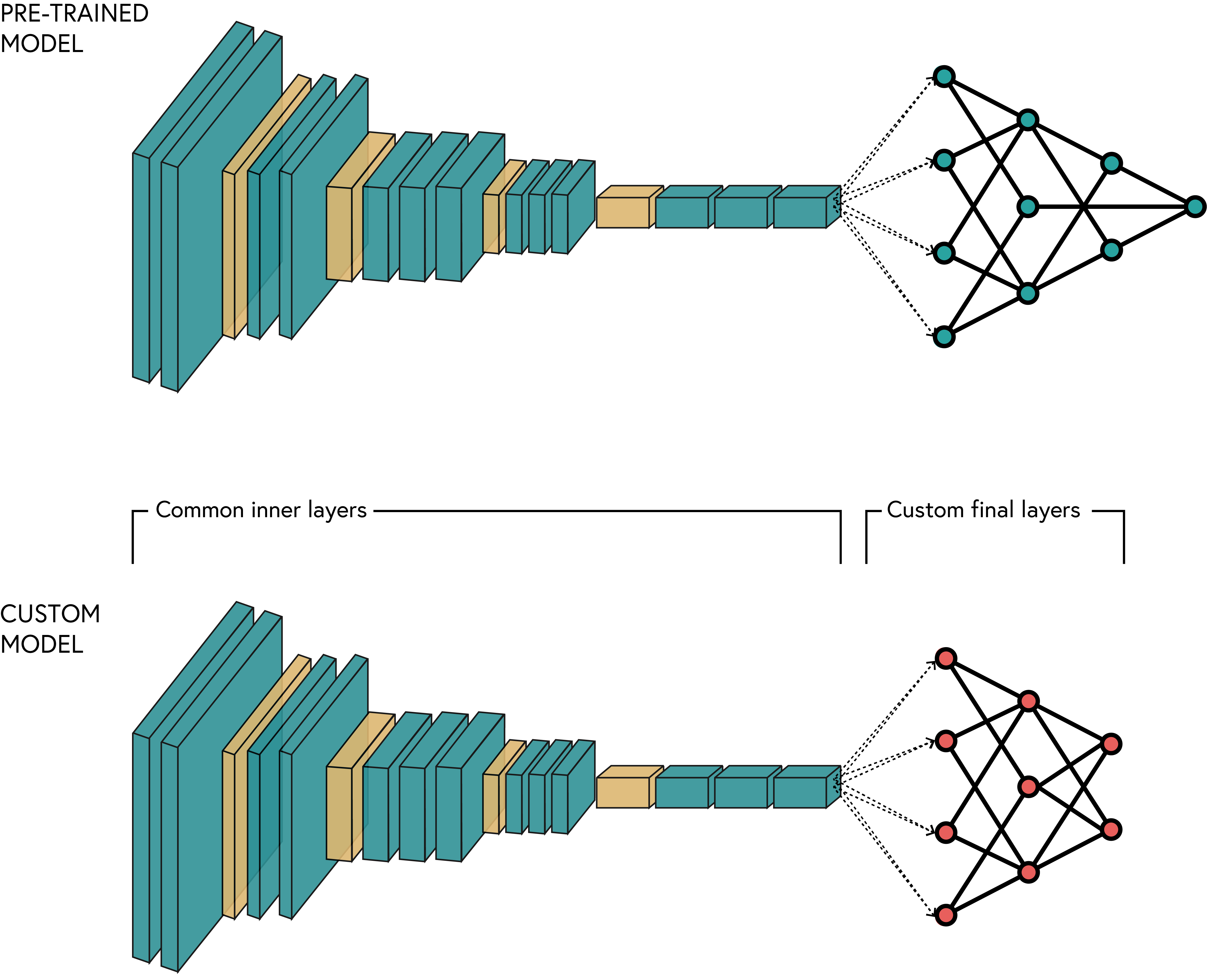
Transfer learning steps
Steps:
Select source model
Feature extraction
Fine-tuning
Model adaptation
SE05
10

Slide 11
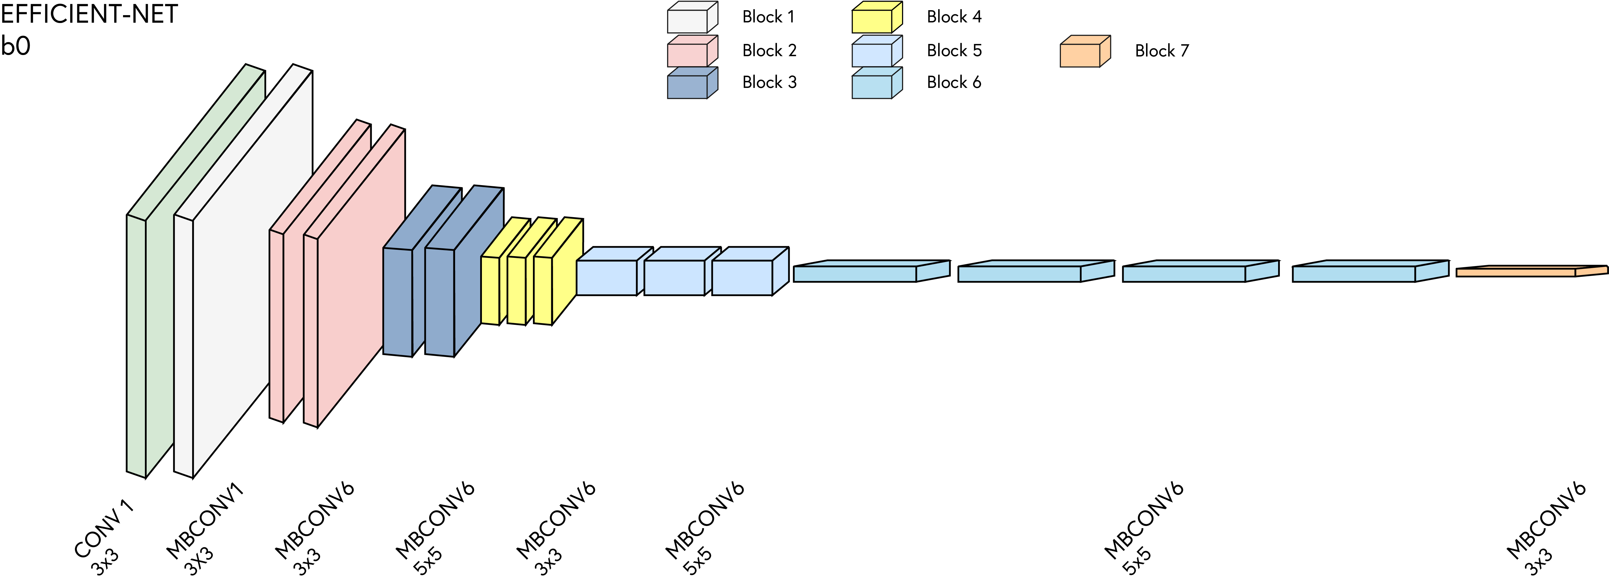
PRE-TRAINED MODELS
ResNet (11.7M-60M parameters)
VGG (138M-144M parameters)
Inception (6.8M-54M parameters)
EfficientNet (5.3M-66M parameters)
MobileNet (4.2M-6.9M parameters)
SE05
11

Slide 12
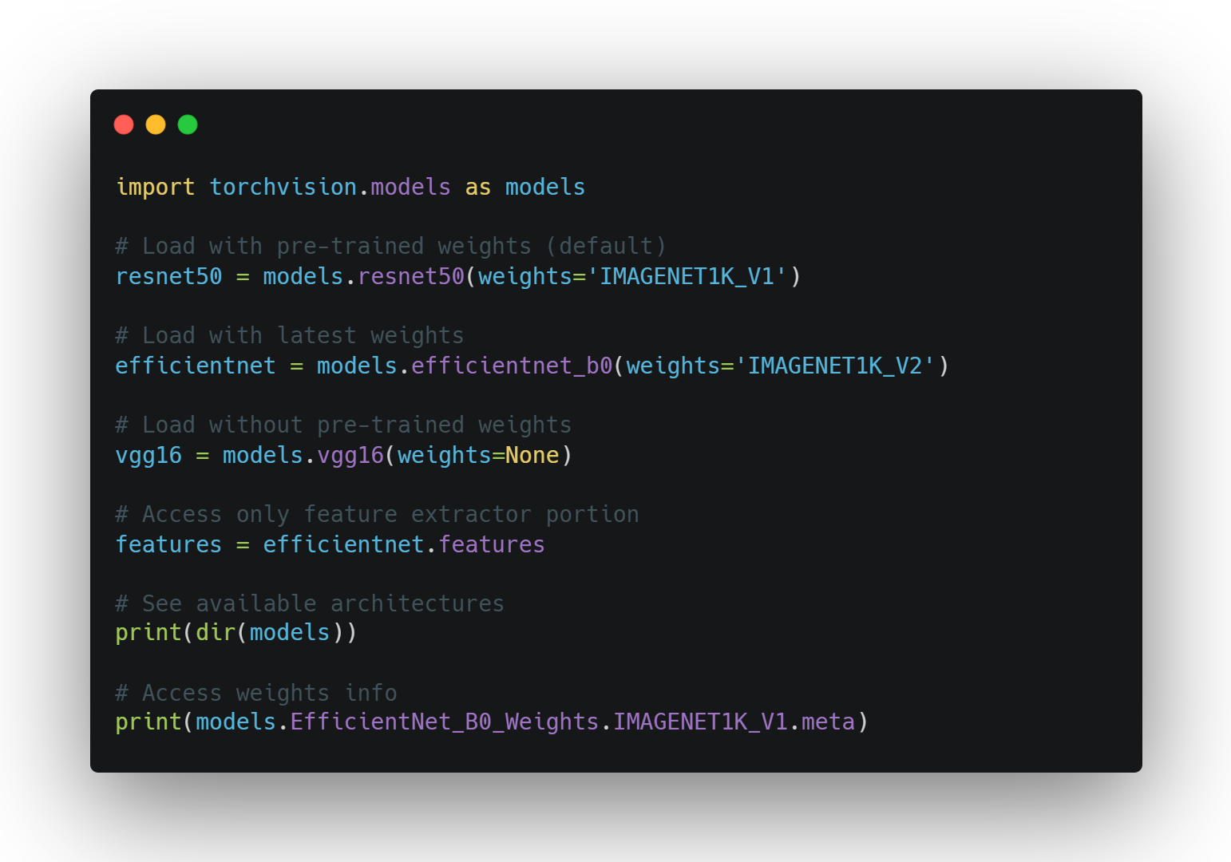
Loading pre-trained models
Torchvision provides easy access to state-of-the-art pre-trained models
Models include weights trained on ImageNet (1.2M+ images, 1000 classes)
Simple API for loading models with or without pre-trained weights
Supports many architectures: ResNet, EfficientNet, VGG, MobileNet, etc.
SE05
12

Slide 13
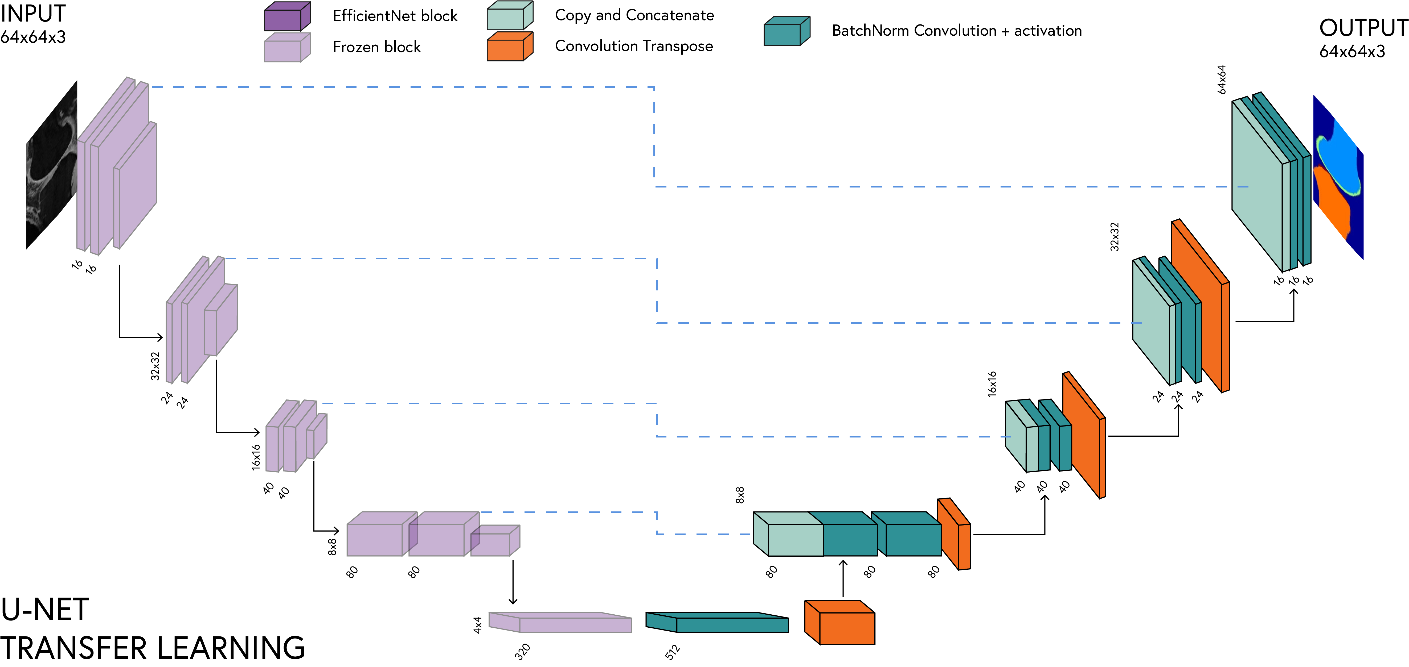
Replace standard encoder with pre-trained EfficientNet
Freeze pre-trained weights to preserve learned features
Train only decoder layers initially
EFFICIENT U-NET
SE05
13

Slide 14
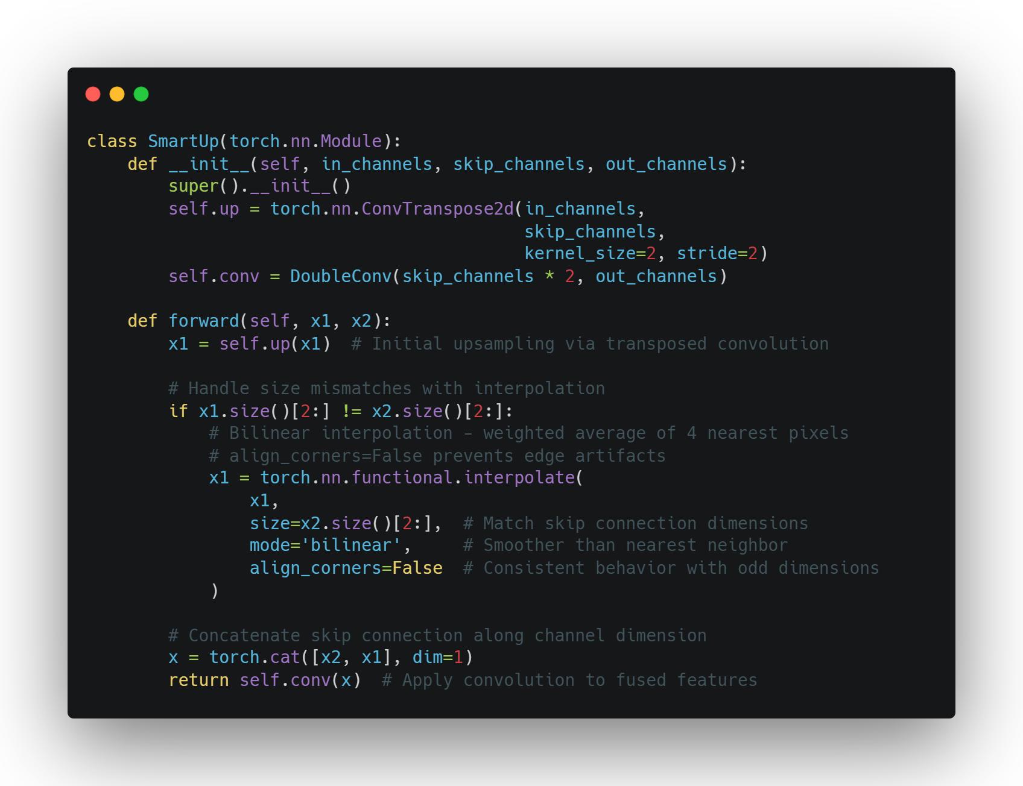
SMART UP BLOCK
Handles feature map size mismatches between encoder and decoder
Employs bilinear interpolation to resolve size discrepancies when needed
Bilinear interpolation creates smoother transitions between pixels compared to nearest-neighbour
Allows flexibility when working with arbitrary encoder architectures
SE05
14

Slide 15
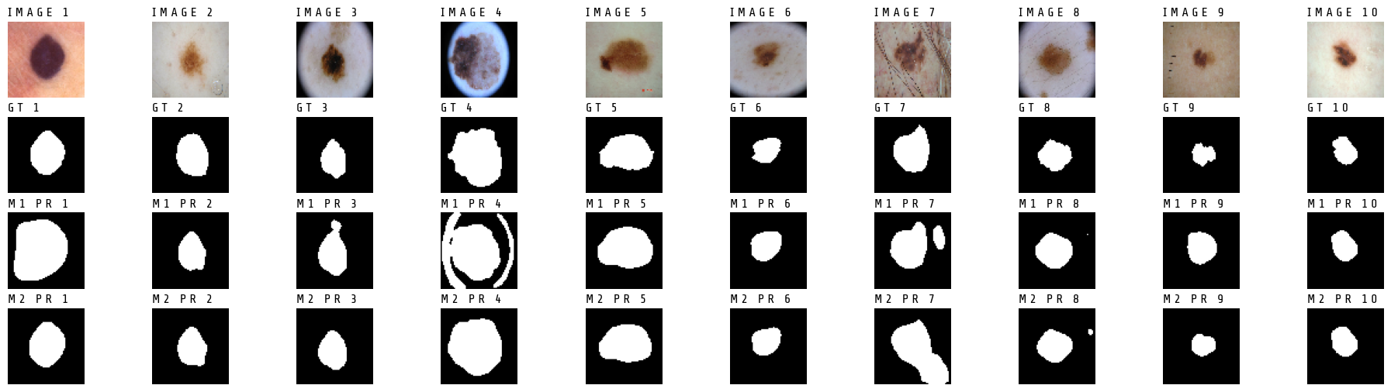
Advantages of t-learning
Reduced training time (5-10x faster)
Works with limited medical imaging data
Better performance with challenging cases
Faster convergence
Lower computational cost
Knowledge retention from source domain

